Slide 1
Artificial Intelligence
Margot Pultar

Slide 2
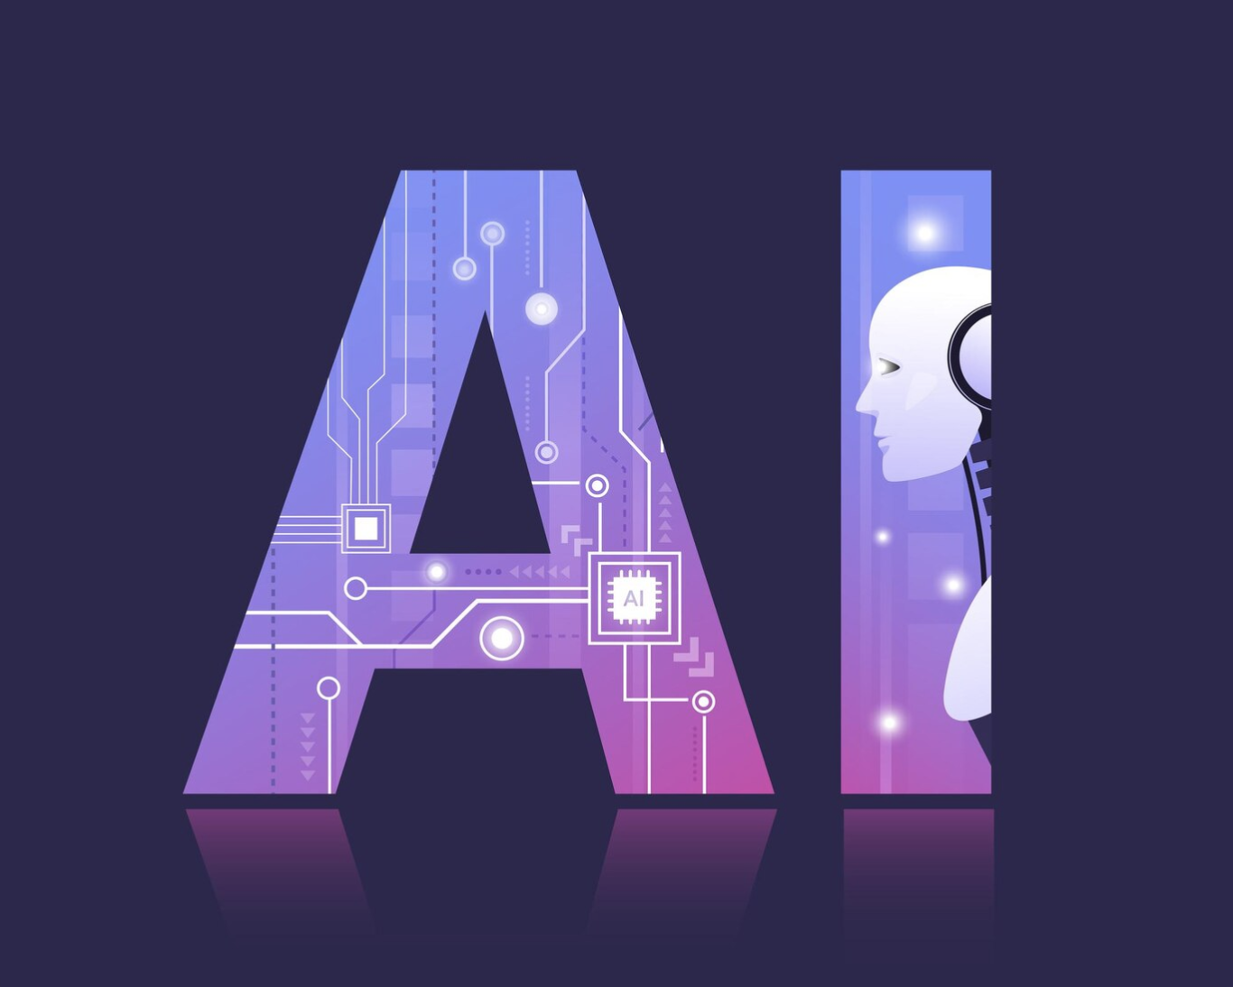
What is Artificial Intelligence?
The idea that machines are able to think as a human does and perform tasks.
Abilities include:
Analyzing and sorting through large data sets
Creating personalized algorithms
Playing a game against user
Text to speech
Produce original data, such as text
(freepik.com)

Slide 3
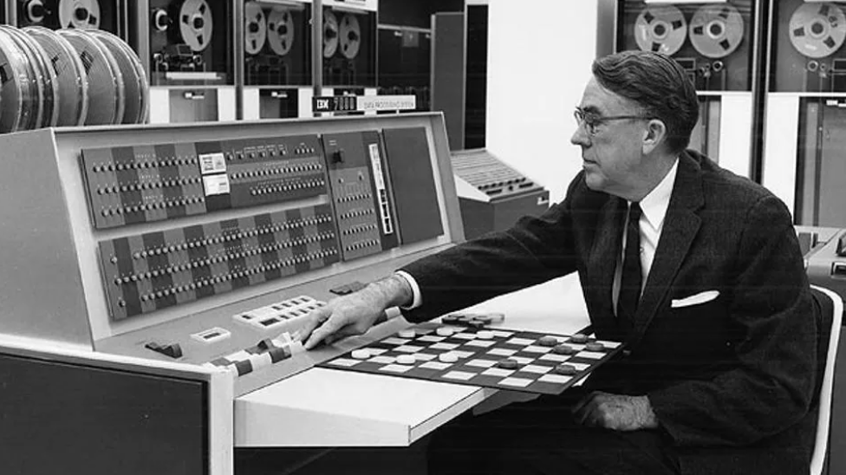
History of AI
Artificial Intelligence was first introduced in the 1950s
1950, Alan turing tested the thinking ability of machines
1952, Arthur Samuel created a chess game, AI played against the user
1955, Convention at Dartmouth College
(Forbes)
2002, Roomba was created
2006, Google Translate
2011, Siri by Apple was released
2023, ChatGPT was made public
Notes:
With this we now have the turing test that is still in use today.
2 years after alan turing, arthur samuel created a chess game, where the machine was able to play against the user utilizing Artificial intelligence.
The convention at dartmouth college coined the term “artificial intelligence”
1961, robot was created for use in a factory.

Slide 4
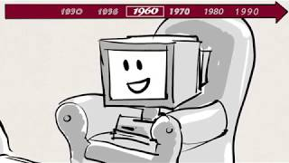
History of AI- Video

Slide 5
Subsets of AI
Deep Learning
Learns from its mistakes and improves itself
Artificial neural network: mimics the brain structure
Utilizes more data
Machine Learning
Can evolve and improve without the need of programmers
Uses less data

Slide 6
Weak vs Strong AI
WEAK
Can only complete one task at a time
Only form of AI we have developed
Despite the name, it is very powerful
Faster & more efficient than humans
Also known as “Narrow AI”
STRONG
Complete tasks in a way that only humans can
Does not exist yet
Also known as Artificial General Intelligence
Gains emotional aspect
Can adapt as a human would

Slide 7
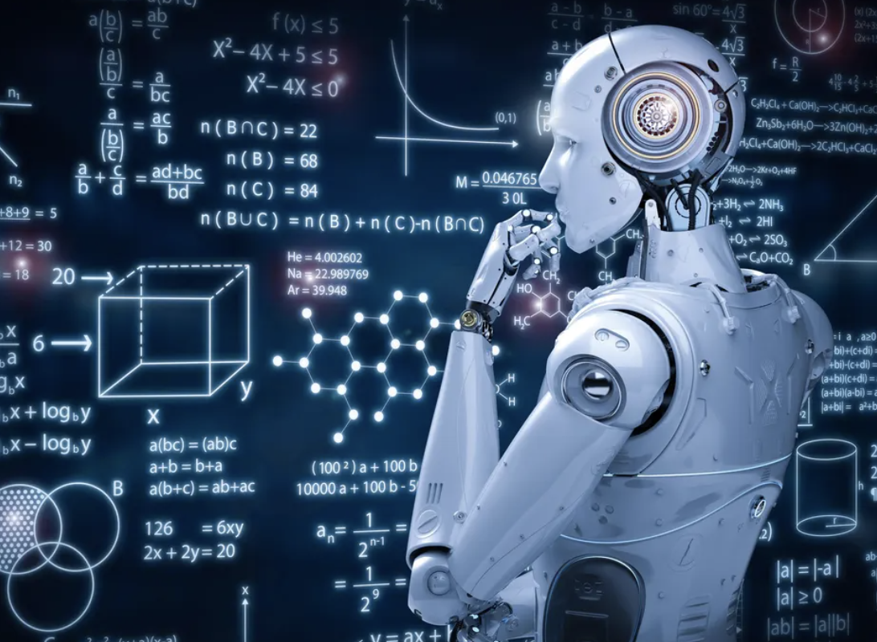
Types of AI
There are 4 different kinds of Artificial Intelligence:
Reactive Machines
Set of functions
Can’t learn and evolve on their own
Theory of Mind
Can understand humans on emotional level
Not yet programmed
Limited Memory
Learns from data its given
Most applications are Limited Memory AI
Self Aware
Has emotions, is aware of its existence
Not yet programmed, and far from it
(Forbes)

Slide 8
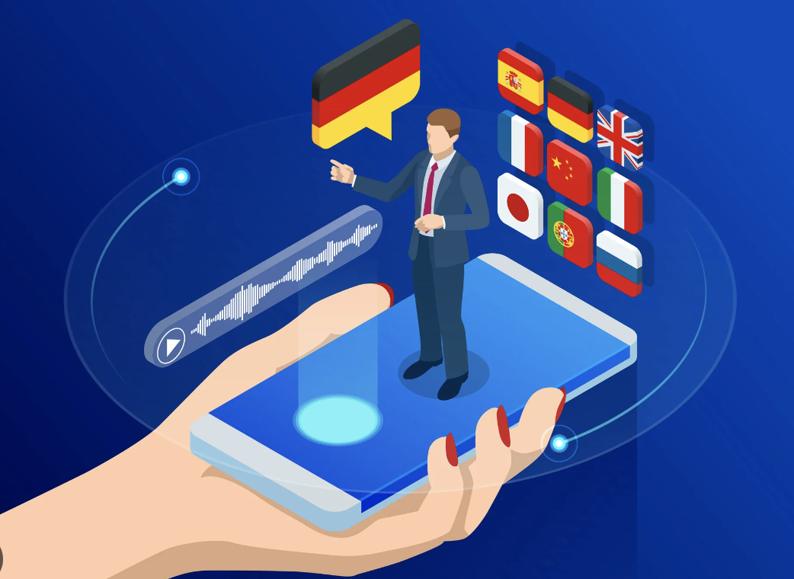
Benefits of AI
Pros:
Improves accessibility for those who need accommodations
Protection
Ex: AI in banking alerts us to fraudulent activity and scams
Translation applications
Faster processing speed
Can sift through large amounts of data
Personalized algorithms
Cheaper and faster than humans
(Verdict.co.uk)

Slide 9
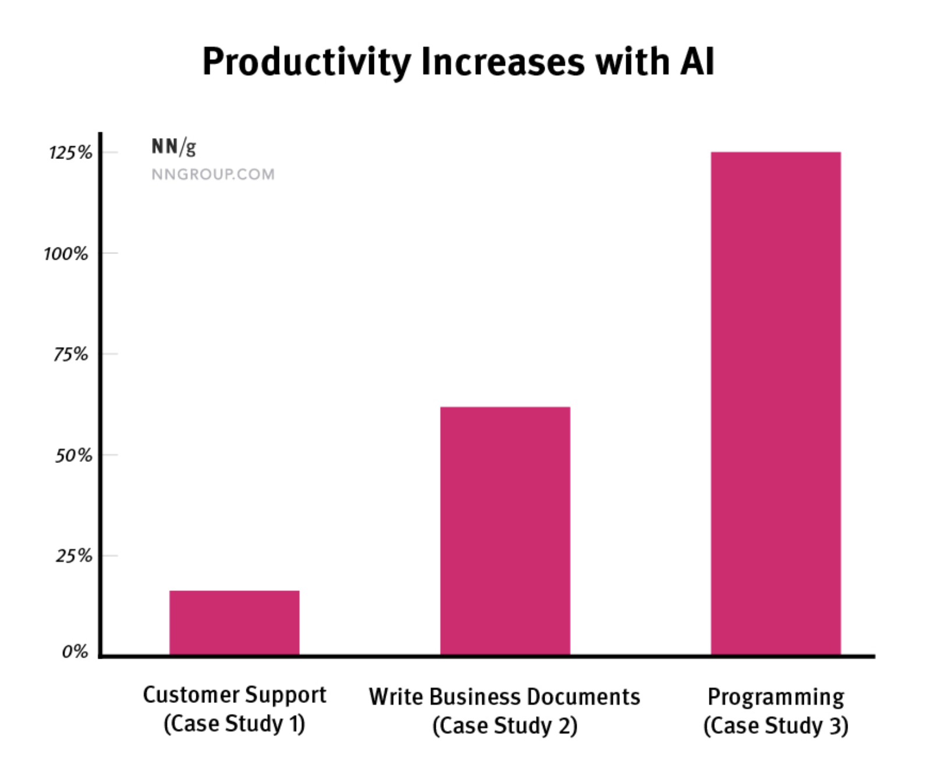
AI and Productivity
Study of multiple different groups using AI to aid in their everyday job tasks
-Programming up 125%
- Most challenging tasks were helped by AI
-“Generative AI tools increased business users’ throughout by 66% when performing realistic tasks” (NNgroup)
https://www.nngroup.com/articles/ai-tools-productivity-gains/

Slide 10
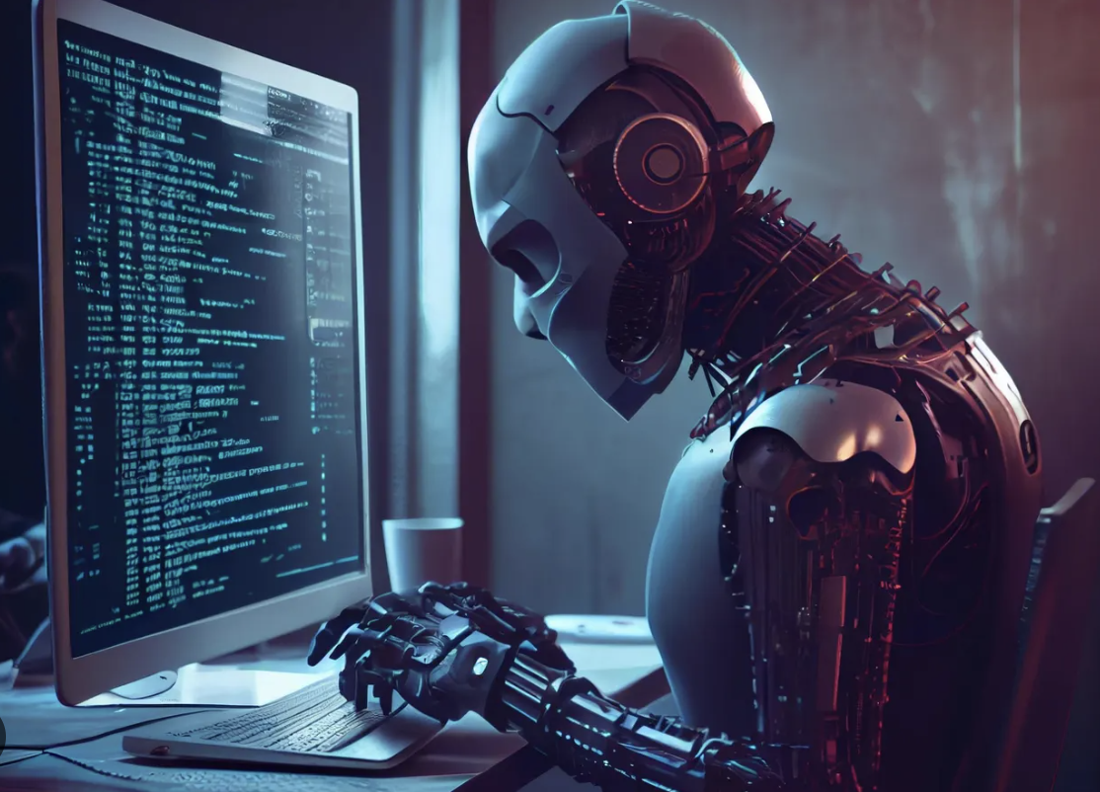
Negatives of AI
(Forbes)
Cons:
Jobs taken over by AI
Biases from data its collected
Scalper bots
Bots
Automated scams
Generative AI
Can be used in negative ways

Slide 11
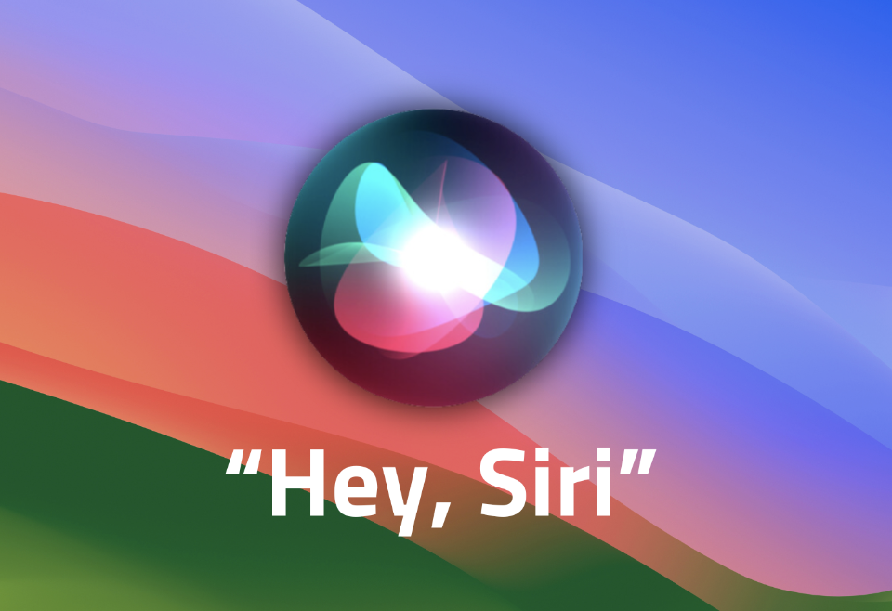
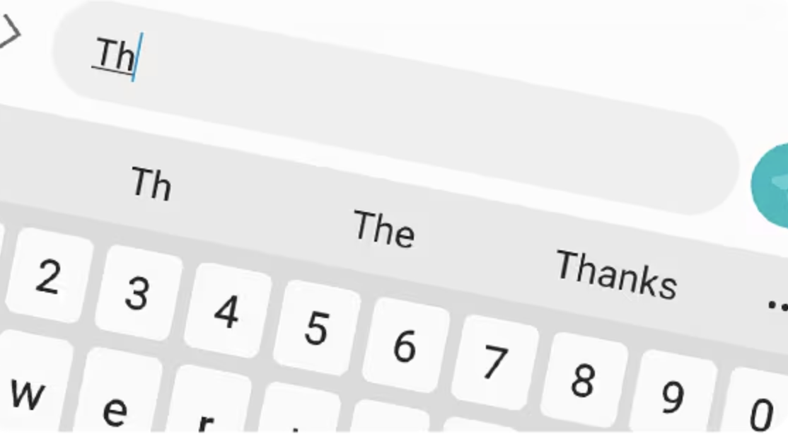
Everyday use
We use Artificial Intelligence everyday without even realizing it, some examples include:
Social Media
Online shopping
Banking
Navigation apps
Siri/Alexa
Texting/Emails
Gaming
(macsales.com)
(samsung.com)

Slide 12
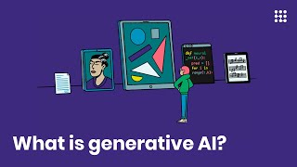
Generative Artificial Intelligence
Generative AI creates new content/data for the user based on commands.
Examples of Generative AI:
ChatGPT
Bard
Text to speech

Slide 13
Job Security
A large concern for many is the potential for AI to replace them at work.
Jobs most at risk:
Information Technology
Legal positions
Coding jobs
“Knowledge jobs”
The jobs that are the safest from AI are hands on jobs, such as construction, cleaning, medical, etc.
AI Jobs:
AI engineer
Machine learning engineer
Software engineer

